Slide 1
PROJECT TITLE : BLINKIT SALES ANALYTICS DASHBOARD
Presented By:
Name:Surabhi H L
USN:4JD22IS064
Name:Sinchana P M
USN:4JD22CS102
Name:Dhanyashree A S
USN:4EG22AI010
Guide name:
Kavya NC

Slide 2

INTRODUCTION
• In Today’s fast-paced digital business environment, data analytics has become essential in the e-commerce and quick-commerce industry for improving business performance and decision-making.
• Traditional methods of analyzing sales data using spreadsheets and manual reports are time-consuming, inefficient, and difficult to manage for large datasets. To overcome these challenges, we developed a Blinkit Sales Analytics Dashboard.
• The dashboard integrates Python, Streamlit, Pandas, and Plotly to automate sales analysis, provide interactive visualizations, and generate KPI metrics for better business insights.
• Users can monitor sales performance, outlet efficiency, product trends, and customer preferences through an interactive dashboard interface, ensuring faster analysis and accurate reporting.

Slide 3
PROBLEM STATEMENT
Design and develop an interactive Blinkit Sales Analytics Dashboard to overcome the difficulties of manual sales data analysis, which is time-consuming, inefficient, and prone to human errors. The system should provide clear visualizations and KPI metrics to help businesses analyze sales performance, customer preferences, outlet efficiency, and product trends effectively.
The dashboard must address challenges such as handling large datasets, lack of proper sales monitoring, difficulty in identifying top-performing products and outlets, and delayed business decision-making by delivering automated, accurate, interactive, and real-time business insights through charts, filters, and data visualization techniques.

Slide 4
OBJECTIVES
• To analyze grocery sales data
• To identify top-performing products
• To understand outlet performance
• To reduce manual data analysis
• To create dashboards for decision making

Slide 5
SCOPE OF THE PROJECT
The Project is mainly focused on analyzing Blinkit sales data and generating business insights through interactive dashboards. The dashboard allows users to monitor sales performance, outlet details, product categories, and customer preferences. The project includes modules such as KPI analysis, sales visualization, outlet analysis, and filter-based reporting. It can be further enhanced in the future by adding machine learning predictions, cloud deployment, and real-time analytics.

Slide 6
EXISTING SYSTEM
• Data stored in Excel sheets
• Manual analysis of sales data
• No proper visualization tools
• Time-consuming and error-prone
• Difficult to track performance

Slide 7
PROPOSED SYSTEM
• Automated data preprocessing using Python
• Data storage using MySQL
• Interactive dashboards using Power BI
• Web dashboard using Streamlit
• Better visualization and insights

Slide 8






TECHNOLOGY STACK
Frontend:
• Streamlit (Web Dashboard)
Backend:
• Python
Database:
• MySQL
Tools:
• Jupter Notebook
• VS Code
• Power BI

Slide 9
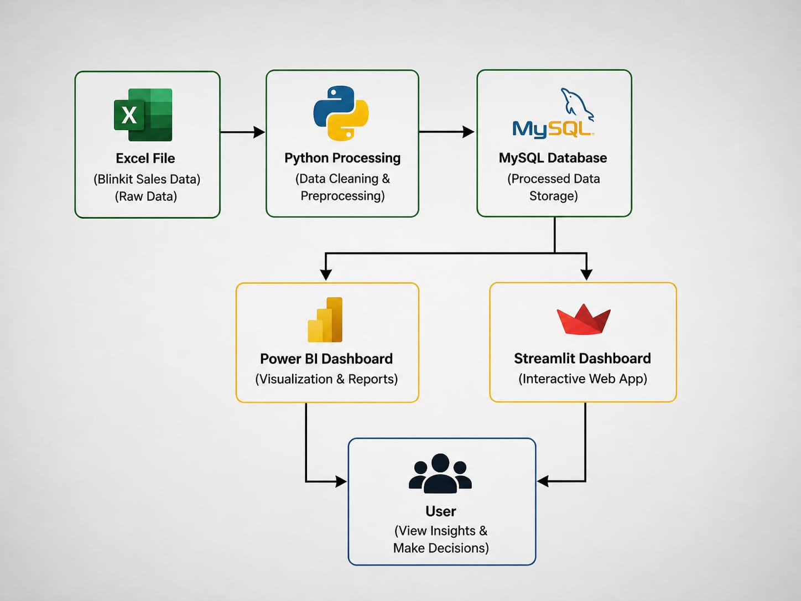
SYSTEM ARCHITECTURE

Slide 10
MODULES OF PROJECT
Data Collection Module
• Collect Blinkit sales dataset (Excel/CSV)
Data Preprocessing Module
• Handle missing values (Item_Weight) , Remove duplicates
Clean categorical data (Fat Content)
3. Data Transformation Module
• Convert data types ,Create new features (Outlet Age, etc.)
4. Data Storage Module
• Store cleaned data in MySQL database
5. Data Analysis Module
• Perform aggregation (Sales, Ratings, Items) ,identify trends and patterns

Slide 11
6. Visualization Module (Power BI)
• Create interactive dashboard , Charts: Sales, Item Type, Outlet analysis
7. Web Dashboard Module (Streamlit)
• Build interactive UI with filters,Display KPIs and charts
8. User Interaction Module
• Users apply filters and view insights
9. Reporting Module
• Generate insights for decision making
10. Deployment Module
• Run Streamlit app locally

Slide 12
DATABASE DESIGN
Items Table
Field Name | Description
Item_Identifier | Unique ID for each product
Item_Type | Product category
Item_Fat_Content | Fat content of product
Item_Weight | Weight of product
Item_MRP | Maximum retail price
Outlet Table
Field Name | Description
Outlet_Identifier | Unique outlet ID
Outlet_Size | Size of outlet
Outlet_Location_Type | Outlet location category
Outlet_Type | Type of outlet
Outlet_Establishment_Year | Outlet establishment year
Sales Table
Field Name | Description
Item_Identifier | Product ID
Outlet_Identifier | Outlet ID
Item_Outlet_Sales | Sales amount

Slide 13
RELATIONSHIP BETWEEN TABLES
Items table is connected with Sales table using Item_Identifier.
Outlet table is connected with Sales table using Outlet_Identifier.
Sales table stores transaction and sales details for products sold in different outlets.

Slide 14
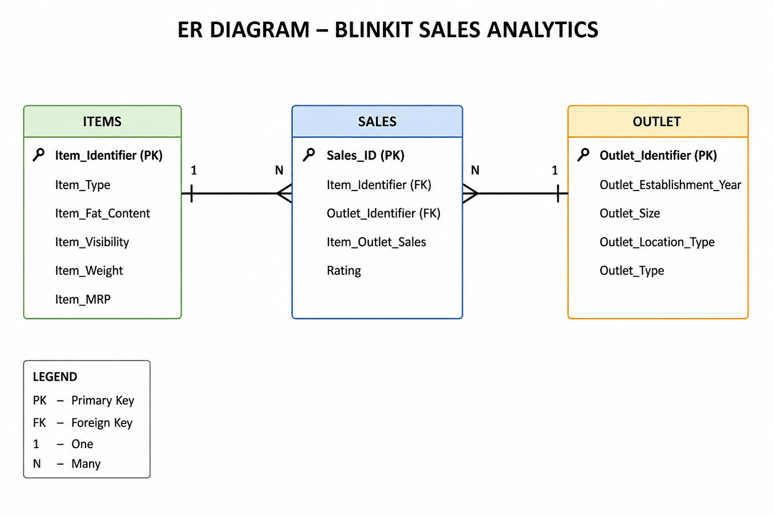

Slide 15
EXPECTED OUTCOMES
Improved business analysis
Faster sales reporting
Better visualization of data
Reduced manual effort
Accurate identification of top-performing products and outlets
Better decision-making using KPI metrics and charts

Slide 16
FUTURE ENHANCEMENTS
Add real-time data integration
Deploy dashboard on cloud platforms
Add machine learning prediction models
Develop mobile-friendly dashboard
Add customer recommendation system
Integrate AI-based analytics

Slide 17
CONCLUSION
The Blinkit Sales Analytics Dashboard successfully analyzes and visualizes sales data using interactive charts and KPI metrics. The project helps businesses understand customer preferences, outlet performance, and sales trends effectively. The dashboard reduces manual work, improves data analysis accuracy, and supports data-driven business decisions. This project demonstrates the practical application of data analytics and business intelligence in the e-commerce industry.

